Slide 1
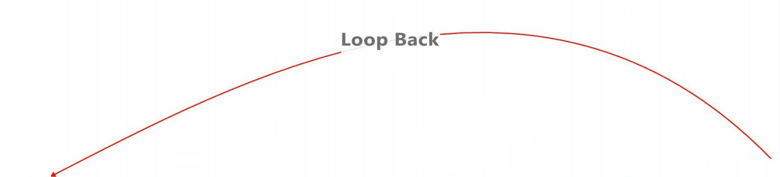
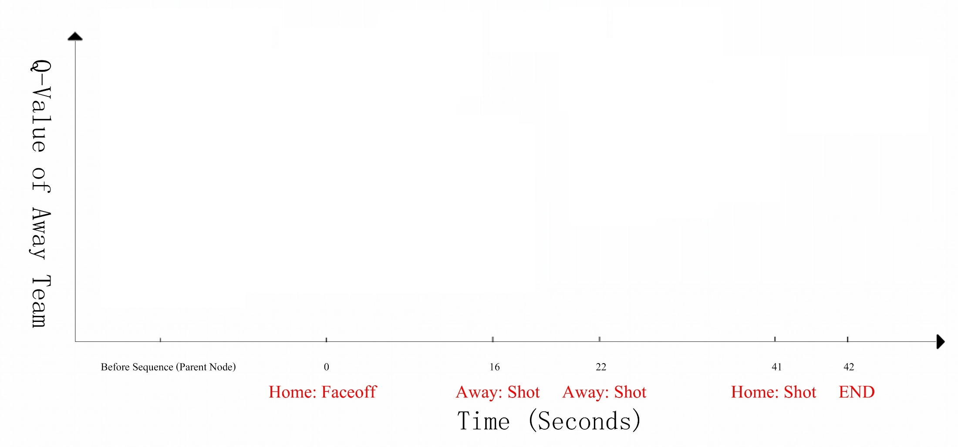
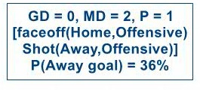
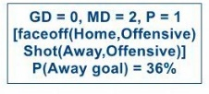
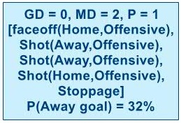
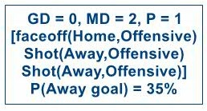
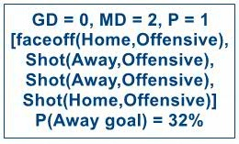
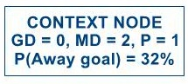
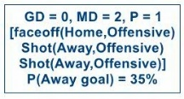
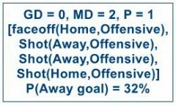
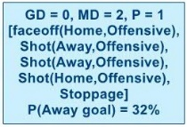
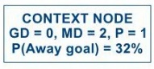
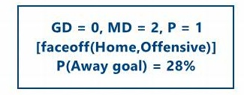





Slide 2
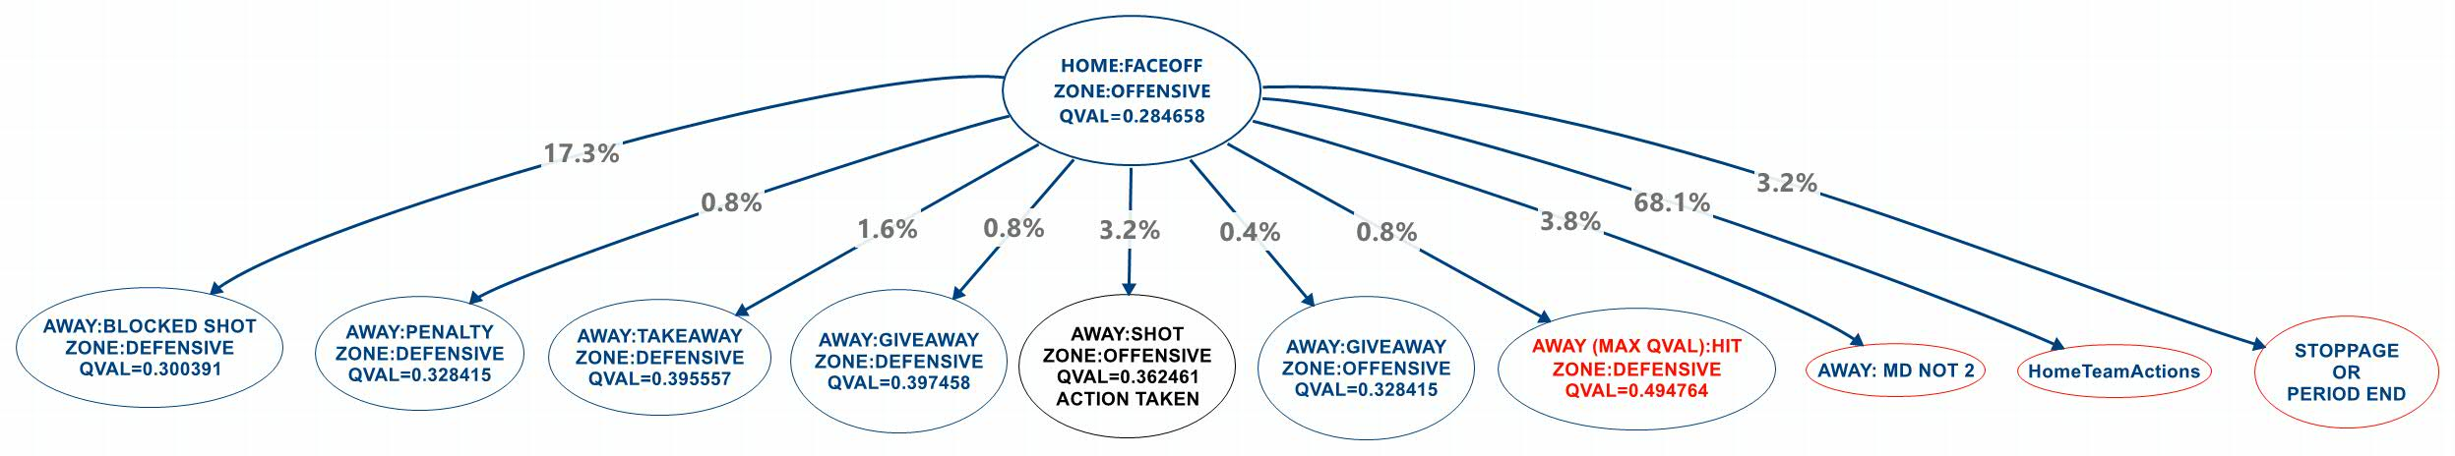
Local Transition Example (1)
GD = 0, MD = 0, P = 1
[PERIOD START,
faceoff(Home, Neutral),
Shot(Away,Defensive)]
3.2%
GD = 0, MD = 0, P = 1
[PERIOD START,
faceoff(Home, Neutral)]
Comments:
The text needs to be much larger. Should be 18 points at least. If necessary, you can drop some nodes. Another possibility is to arrange the nodes horizontally.
Also, you need to make the notation consistent with the state notation in the UAI paper. Please reread the paper. They should include sequence information.
Notes:
Away: MD Not 2 = Penalty Ends.

Slide 3
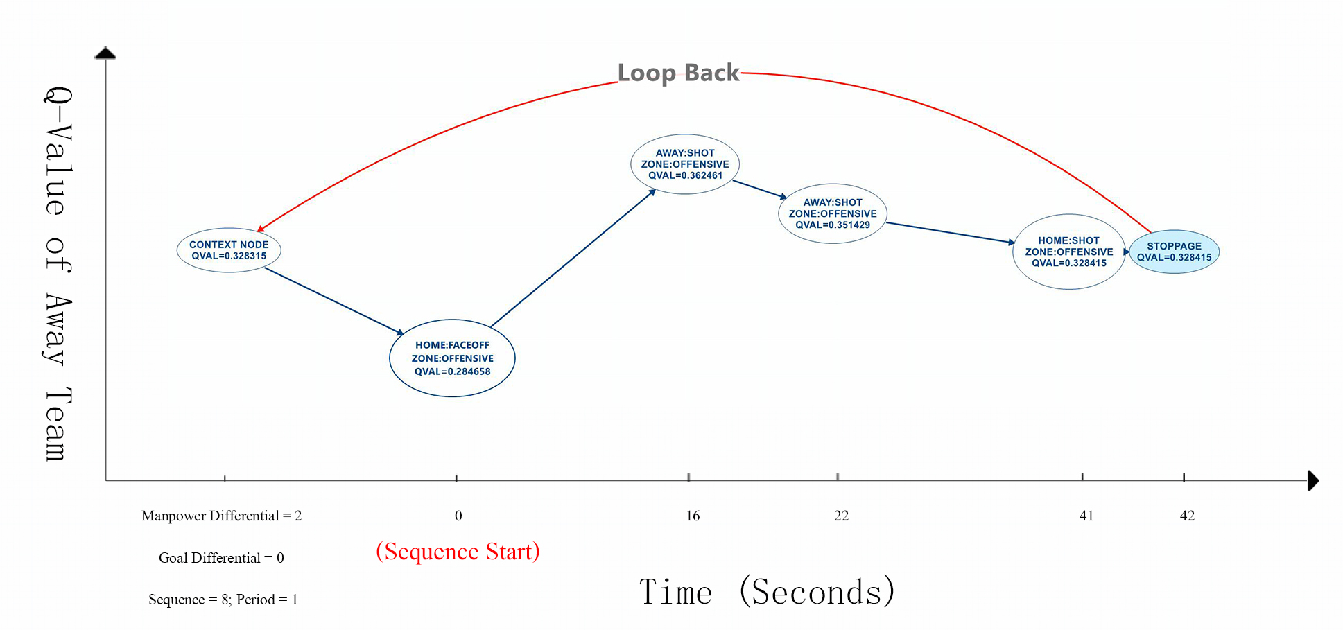
Q-value Ticker
GD = 0, MD = -2, P = 1 [faceoff(Home,Offensive),
Shot(Away,Offensive)]
P(Away goal) = 36%
GD = 0, MD = -2, P = 1
P(Away goal) = 32%
GD = 0, MD = -2, P = 1 [faceoff(Home,Offensive),
Shot(Away,Offensive),
Shot(Away,Offensive)]
P(Away goal) = 35%
GD = 0, MD = -2, P = 1 [faceoff(Home,Offensive)]
P(Away goal) = 28%
GD = 0, MD = -2, P = 1 [faceoff(Home,Offensive),
Shot(Away,Offensive),
Shot(Away,Offensive),
Shot(Home,Offensive)]
P(Away goal) = 32%
GD = 0, MD = -2, P = 1 [faceoff(Home,Offensive),
Shot(Away,Offensive),
Shot(Away,Offensive),
Shot(Home,Offensive),
Stoppage]
P(Away goal) = 32%
Comment:
make consistent with paper notation as shown.
on x-axis, add information about which player performs the action.
E.g John Smith wins a face-off at 0 seconds.
Home team: COLORADO AVALANCHE
Away team: ST. LOUIS BLUES.
Sequence Number = 8
Reward = Next Goal
Notes:
Natural to look at difference
Improve this by labelling edges with actions.
Title of y-axis: Q-value = Probability of Away Goal

Slide 4
Q-value Ticker
GD = 0, MD = -2, P = 1 [faceoff(Home,Offensive),
Shot(Away,Offensive)]
P(Away goal) = 36%
GD = 0, MD = -2, P = 1 [faceoff(Home,Offensive),
Shot(Away,Offensive),
Shot(Away,Offensive)]
P(Away goal) = 35%
GD = 0, MD = -2, P = 1 [faceoff(Home,Offensive),
Shot(Away,Offensive),
Shot(Away,Offensive),
Shot(Home,Offensive)]
P(Away goal) = 32%
GD = 0, MD = -2, P = 1 [faceoff(Home,Offensive),
Shot(Away,Offensive),
Shot(Away,Offensive),
Shot(Home,Offensive),
Stoppage]
P(Away goal) = 32%
GD = 0, MD = -2, P = 1
P(Away goal) = 32%
GD = 0, MD = -2, P = 1 [faceoff(Home,Offensive)]
P(Away goal) = 28%
Comment:
make consistent with paper notation as shown.
on x-axis, add information about which player performs the action.
E.g John Smith wins a face-off at 0 seconds.
Home team: COLORADO AVALANCHE
Away team: ST. LOUIS BLUES.
Sequence Number = 8
Reward = Next Goal
John Smith wins faceoff
Jane Smith shoots on goal
Notes:
Natural to look at difference
Improve this by labelling edges with actions.
Title of y-axis: Q-value = Probability of Away Goal

Slide 5


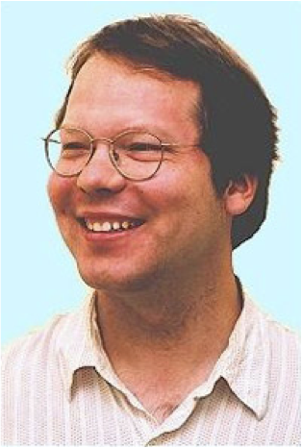


A Markov Game Model for Valuing Player Actions in Ice Hockey
Kurt Routley
Oliver Schulte
Zeyu Zhao
Tim Schwartz
To Appear
at UAI 2015

Slide 6
Big Picture: AI Meets Sports Analytics Meets Big Data
North American Sports: $485 Billion
Sports Analytics:
growing in industry.
$72.5M Investment in Hudl.
growing in academia.
#Sports Analytics papers 2008-2015 = 7x #applied operations research papers.
AI
modelling and learning game strategies.
multi-agent systems.
structured data.
Notes:
https://www.plunkettresearch.com/industries/sports-recreation-leisure-market-research/
hudl.com

Slide 7
Player Performance Evaluation

Slide 8

Two Main Problems in Sports Analytics
Sports Analytics
Evaluate Player Performance
Predict Match Outcomes
See also ECML Sports Analysis Workshop
Notes:
https://dtai.cs.kuleuven.be/events/MLSA15/index.php
Add money ball picture

Slide 9
Performance Evaluation: Action-Based Approaches
Basic question: What difference does an action make?
Quantify effect of action on outcome (goal) = action value.
Player contribution = sum of scores of player’s actions.
Schuckers and Curro (2013), McHall and Scarf (2005; soccer).
Example: +/- Score in ice hockey
nhl.com Advanced Stats
Notes:
Action examples. E.g. face-off win -> shot on target.
http://www.nhl.com/stats/player?navid=nav-sts-indiv#
http://thehockeymovement.com/advanced-stats-for-beer-league-hockey/
Problem: different valuable actions, how to combine?

Slide 10
Reinforcement Learning and Action Value
Wanted: function mapping action to value.

Slide 11
Reinforcement Learning and Action Value
Wanted: Action-value function.
Notes:
Check index in the bible

Slide 12
Reinforcement Learning and Action Value
Wanted: Q-function.

Slide 13
Q-function and Player Performance
Q(s,a): expected reward of action a starting in state s.
See AIspace demo
Novel features of the Q-function:
The action value depends on the state = context.
Hockey: goal worth more if game is tied (Pettigrew 2015).
Q-function looks ahead to future effects.
Hockey: important because few scores. E.g. Penalty ➔ powerplay ➔goal but not immediately.
Familiar in AI, revolutionary in sports analytics!
Notes:
Low-scoring games like hockey need look ahead.
Contrat with THOR rating, 20 sec lookahead.

Slide 14
Group Analytics
Key feature of sports analytics: group structure.
Compare a player to others.
E.g. replace by average player (virtually).
Machine Learning with class hierarchies.
Shrinkage model, random effects, ANOVA.
Reinforcement Learning with groups of agents: not so much?!

Slide 15
Q-learning for Ice Hockey
The Data

Slide 16
Sports Data Types
Complete Tracking: which player is where when. Plus the ball/puck. ★
Box Score: Action Counts.
Play-By-Play: Action/Event Sequence.
Notes:
Action vs. Event: not clearly distinguished.

Slide 17
Tracking Data
Basketball Example from SportsVU
Coming to the NHL?

Slide 18
Box Score
Oilers vs. Canucks

Slide 19
Play-By-Play
Successive Play Sequences
Oilers vs. Canucks
Big Data: Play-by-play 2007-2015

Slide 20
Q-Learning for Ice Hockey
The Model

Slide 21
Markov Game Models
Transition graph with 5 parts:
Players/Agents P
States S
Actions A
Transition Probabilities T
Rewards R
Transitions, Rewards depend on state and tuple of actions, one for each agent.
Notes:
We use a variant of AD-Trees as a data structure for the Markov Game model
States correspond to nodes
Actions correspond to edges

Slide 22
Team-Level Modelling
Players in our Markov game = {Home, Away}.
Models average or random player.
Notes:
Normal in ice hockey. But not cricket or baseball. Nor in basketball.

Slide 23
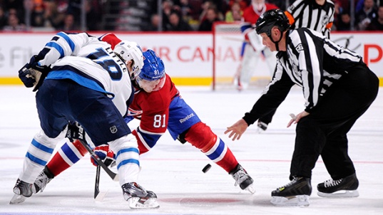
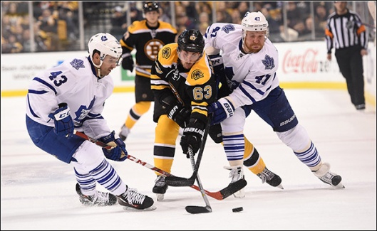
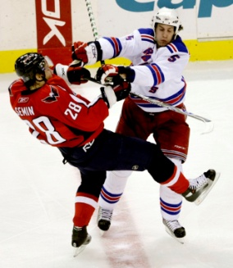
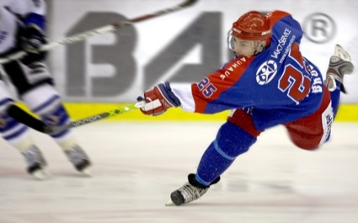
Markov Game Models: State Space
Context Features x
Goal Differential GD
Manpower Differential MD
Period P
Play Sequences
Action History h
[faceoff(Home,Offensive), takeaway(Away,Defensive), hit(Home,Offensive), shot(Home,Offensive)]
State s = <x,h>

Slide 24
Markov Game Models: Actions
8 Player Actions, 9 Start/End of Sequence Markers
Action-Events | Markers
Blocked Shot | Early Intermission End
Faceoff | Early Intermission Start
Giveaway | Game End
Goal | Game Off
Hit | Penalty
Missed Shot | Period End
Shot | Period Start
Takeaway | Shootout Completed
 | Stoppage
Notes:
From NHL.com

Slide 25
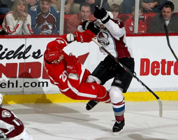
Markov Game Models: Actions
Use action description notation (Levesque et al, 1998)
Actions written in form a(T,Z)
Action a
Team T
Zone Z
faceoff(Home,Neutral)
shot(Home,Offensive)
hit(Away,Defensive)

Slide 26
Markov Game Models: Transitions
Transitions are mapping (s x a) → s’
If s=(x, h), then s’ = (x, h*a)
Transition probabilities are estimated from observances in play-by-play data
Record occurrences of state s as Occ(s)
Record occurrences of transition as Occ(s,s’)
Transition probabilities T estimated as:
Occ(s,s’) / Occ(s)

Slide 27
Markov Game Models: Rewards
Goals
R(s) = 1 if s corresponds to a goal(Home,*)
R(s) = -1 if s corresponds to a goal(Away,*)
R(s) = 0 otherwise
Penalties
R(s) = 1 if s corresponds to a penalty(Home,*)
R(s) = -1 if s corresponds to a penalty(Away,*)
R(s) = 0 otherwise
Wins
R(s) = 1 if s corresponds to a Win(Home)
R(s) = -1 if s corresponds to a Win(Away)
R(s) = 0 otherwise

Slide 28
System Building

Slide 29
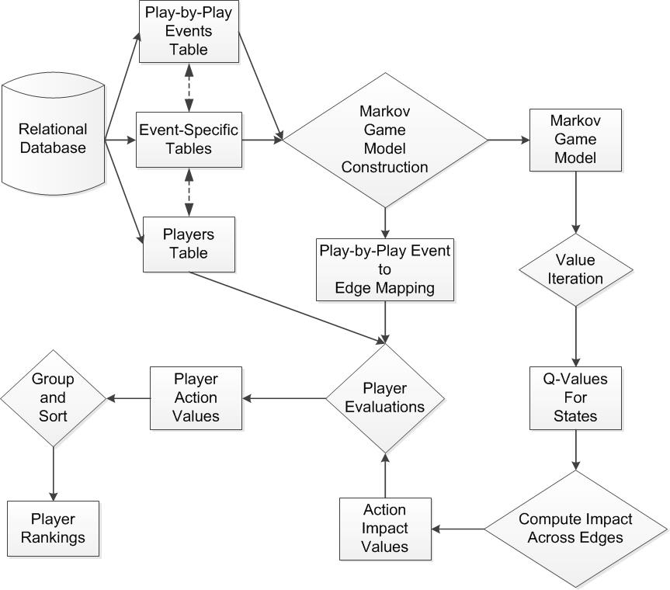
System Overview

Slide 30
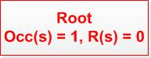
Markov Game Model Construction Algorithm

Slide 31
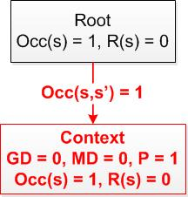
Markov Game Model Construction Algorithm

Slide 32
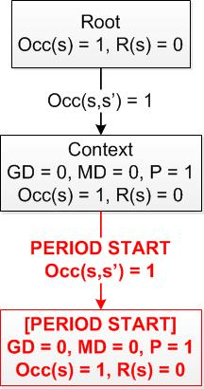
Markov Game Model Construction Algorithm

Slide 33
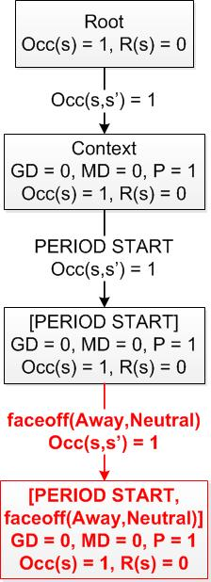
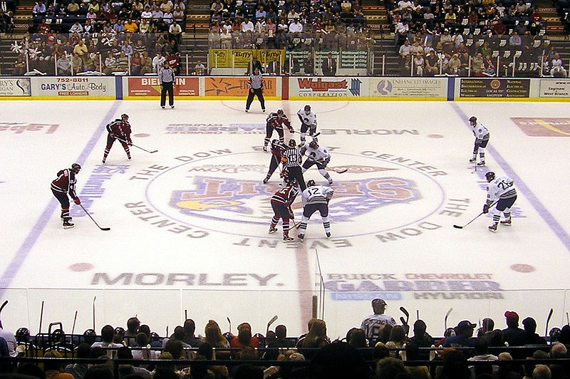
Markov Game Model Construction Algorithm
Actions are appended to state
➔Context + Action Sequence = state sequence

Slide 34
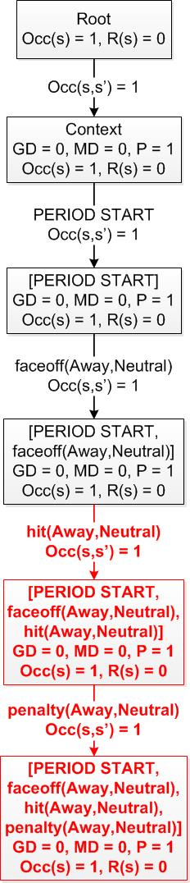
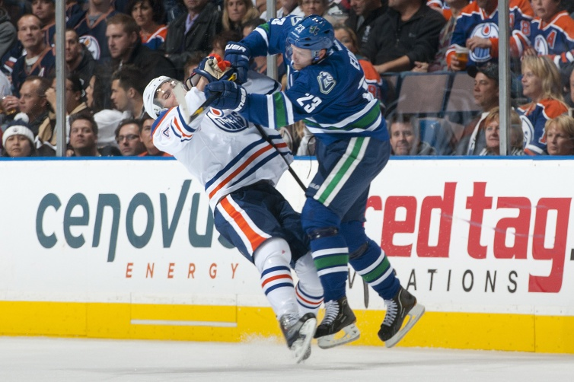
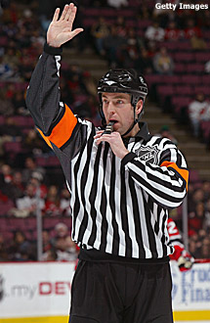
Markov Game Model Construction Algorithm

Slide 35
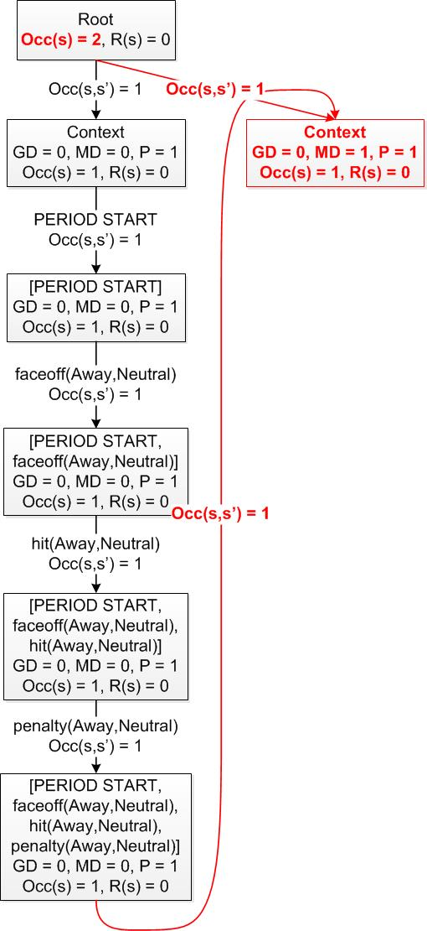
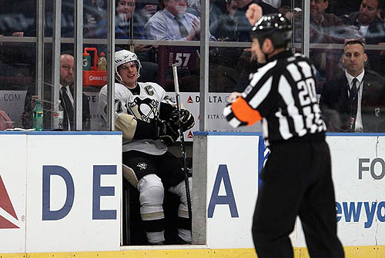
Markov Game Model Construction Algorithm

Slide 36
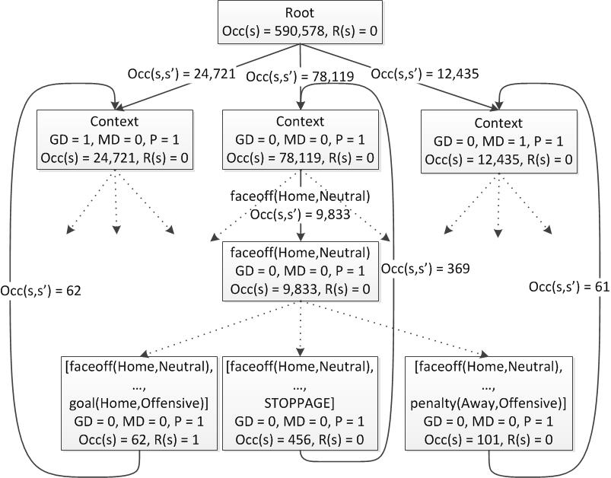
Markov Game Model Transition Graph

Slide 37
Local Transition Example (1)
Notes:
Away: MD Not 2 = Penalty Ends.

Slide 38
Local Transition Example (2)
For Basketball
Notes:
http://projects.yisongyue.com/bballpredict/

Slide 39
The Action-Value Function
Aka Q-function

Slide 40
The Q-Function
Q(s) = Expected reward starting in state s
Reward | Absorbing States | Q(s) represents
Win | Game End | Win Probability Differential
Goals | Game End | Expected Goal Differential
Goals | Game End + Goals | Next Goal Probability Differential
Penalties | Game End | Expected Penalty Differential
Penalties | Game End + Penalties | Next Penalty Probability Differential
Notes:
Modifying the absorbing state changes what Q(s) represents

Slide 41
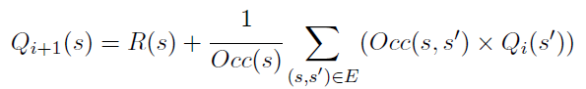
Dynamic Programming Algorithm for Value Iteration
Q-function computation:
Notes:
Factor out occurrences of state to prevent potential issues from numerical instability
No discounting.

Slide 42
Sequence Calibration
Notes:
Add legend for abbreviations, probably drop goals.

Slide 43
Q-value Ticker
Home team: COLORADO AVALANCHE
Away team: ST. LOUIS BLUES.
Sequence Number = 8
Reward = Next Goal
Notes:
Natural to look at difference
Improve this by labelling edges with actions.

Slide 44
Q-value Ticker
Home team: COLORADO AVALANCHE
Away team: ST. LOUIS BLUES.
Sequence Number = 8
Reward = Next Goal
Notes:
Natural to look at difference
Improve this by labelling edges with actions.

Slide 45
Basketball Version

Slide 46
Evaluating Actions
Context-Dependence

Slide 47
Action Impact
Expected reward after action
Expected reward before action
How much does the action change the expected reward at the current state?

Slide 48
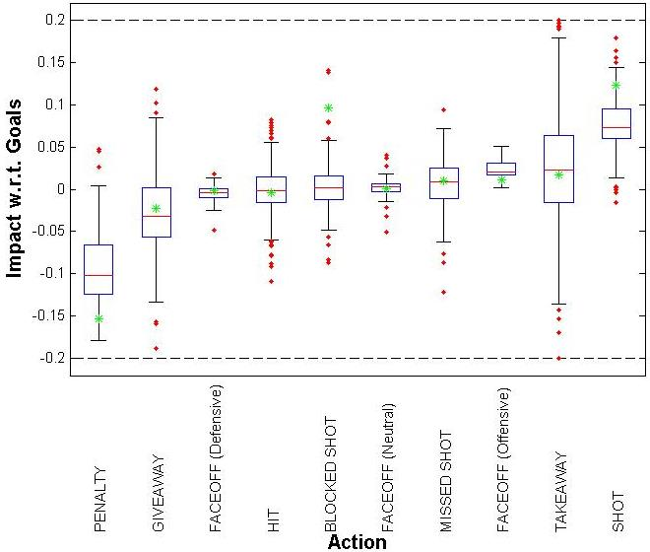
Results: Impact on Goals
Green asterisks represent THoR action values
Notes:
Exclude states with less than 5% frequency
Red line is median value, box is interquartile range, red dots are outliers
Schuckers makes adjustment for shot efficiency

Slide 49
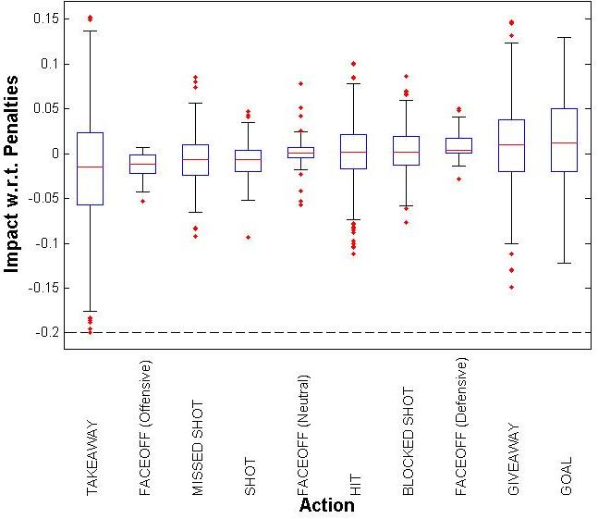
Results: Impact on Penalties

Slide 50
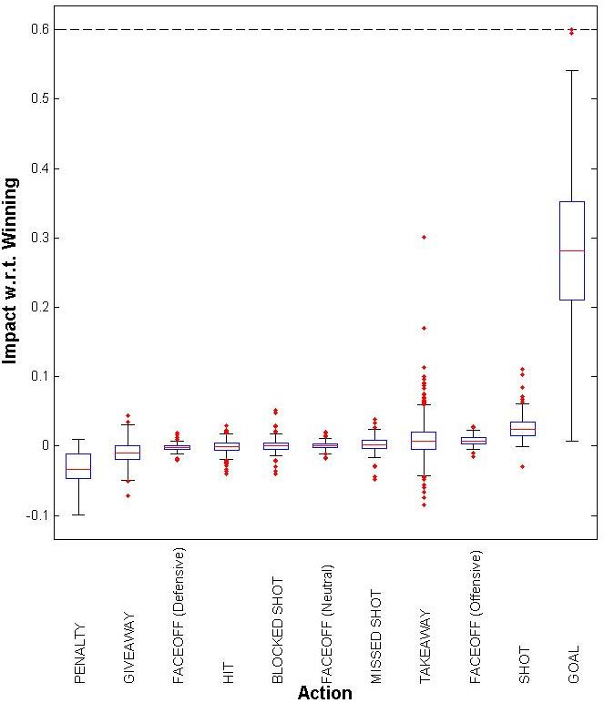
Results: Impact on Winning
Notes:
Interesting that neutral zone faceoffs won appear to be neutral.

Slide 51
Qualitative Examples
Blocked Shot:
Blocking the first shot on net when killing a penalty decreases a team's scoring rate $(impact=-0.0864)$.
Blocking the second shot on net increases the scoring rate $(impact=0.1399)$.
Penalty:
Receiving a penalty when on the powerplay is very bad $(impact=-0.1789)$.
But if a player, while on the penalty kill, receives a penalty while goading their opponent into an offsetting penalty, the penalty actually increases their team's scoring rate $(impact=0.0474)$.

Slide 52
Evaluating Players

Slide 53
Evaluating Players
Apply the impact of an action to the player performing the action
Sum the impact of his actions over a game to get his net game impact
Sum the net game impact of a player over a single season to get his net season impact

Slide 54
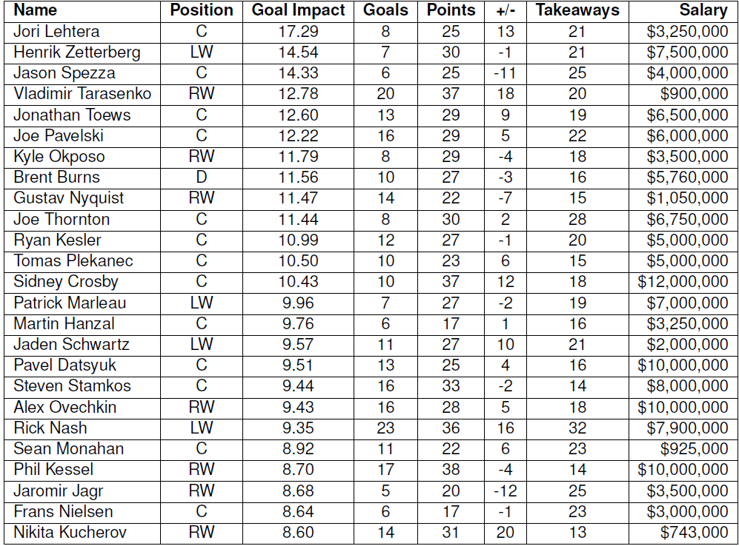
Player Impact on Goals
Notes:
Sort player values for 2014-2015 regular season and display top-25
No Canucks!
Jason Spezza is interesting case, low Pls minus but high goal impact. Played for senators, senators +- was very bad (-29 goal differential).
Jori Lehtera: High Points, low goals, we captures assists.
Sidney Crosby: high salary for goal impacts.

Slide 55
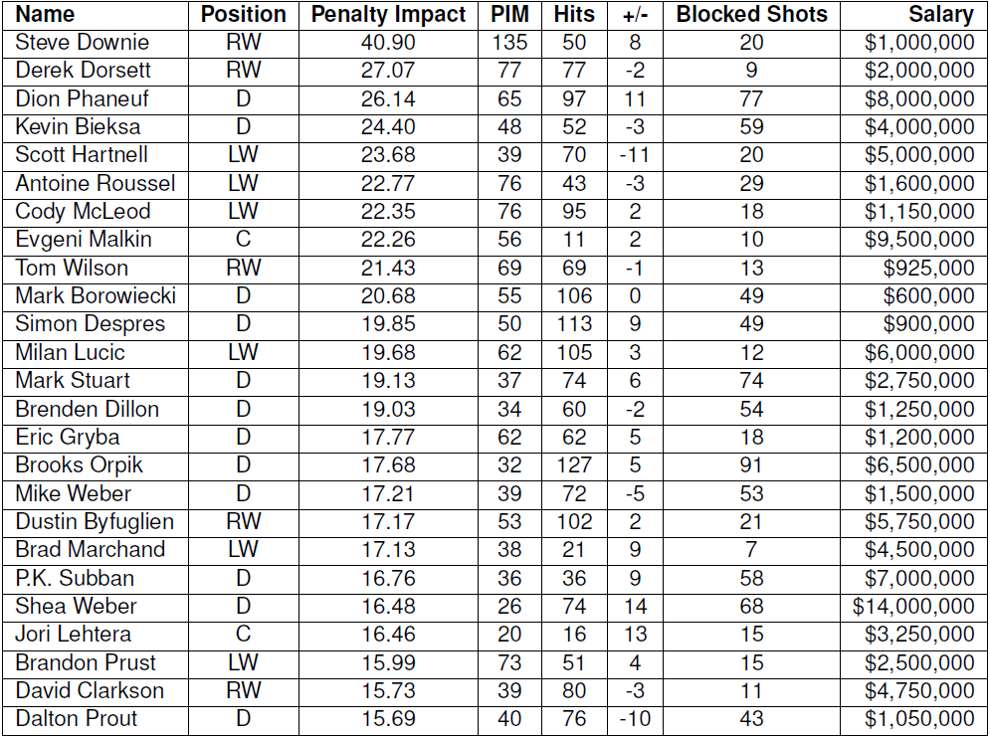
Player Impact on Penalties
Notes:
Penalties are cost, so high value is bad
2 Canucks in top 4: Derek Dorsett and Kevin Bieksa

Slide 56
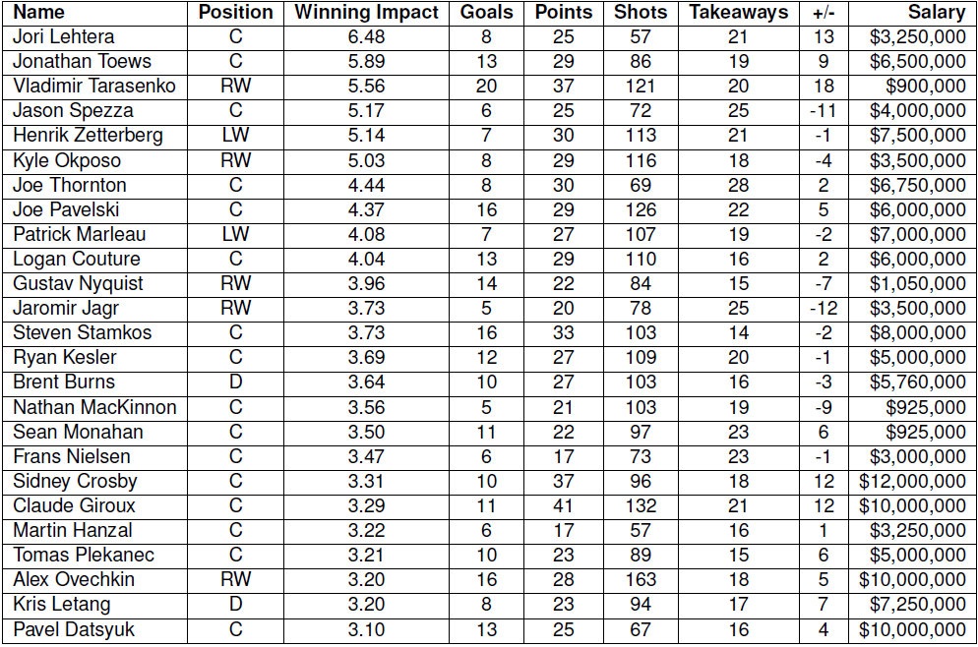
Player Impact on Wins
Notes:
Crosby and Ovechkin’s impact ranking falls from goals to wins, consistent with findings by Pettigrew, where they score many goals but have lower Added Goal Value

Slide 57
Open Questions

Slide 58
Using Player Rankings
No ground truth.
Relate to predicting something (?)
Break down into strong and weak contexts?
Compare Apples-to-Apples.
Cluster players by position.
Learn player clusters.
Interesting ideas in Cervone et al. 2014

Slide 59
Mining the Q-function
Extract patterns about which actions have the most impact when.

Slide 60
Player-Level Modelling
Fit parameters for each player (cricket, baseball, basketball).
Smooth towards similar players when a player visits a state rarely.
Combine reinforcement learning with clustering agents?

Slide 61
Add Continuous Variables
Game Clock.
Penalty Clock.
Player, puck location (eventually).
Can we take existing RL off the shelf?
E.g. continuous finite-time horizon?
Spatial Planning?
RL with both continuous time and space?

Slide 62
Conclusion
Modelling ice hockey dynamics in the NHL.
A new context-aware method for evaluating actions and players.
A configurable and scalable Markov Game model that incorporates context and long-term effects of actions.
“We assert that most questions that coaches, players, and fans have about basketball, particularly those that involve the offense, can be phrased and answered in terms of EPV [i.e. the Q-function].” Cervone et al. 2014.

Slide 63
Q&A
Thank you

